Slide 1
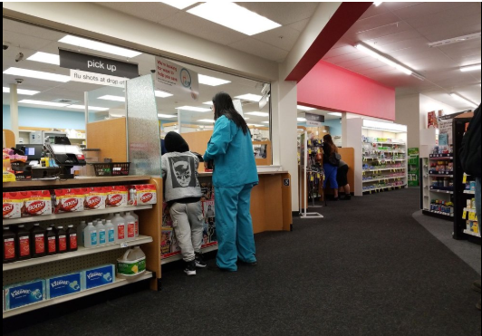



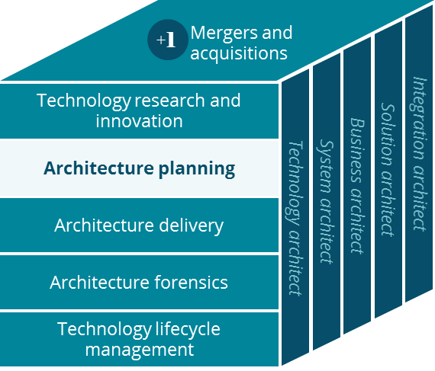
EHR Access PoV
Architecture Planning
David Fitzgerald, Hari Viswanathan and Kathy Filkins
August 2019

Slide 2


Executive Summary
The Electronic Health Record (EHR) Integration landscape is complex and requires significant integration efforts. The EHR landscape is rapidly changing with adoption of newer standards
Opportunity
Conclusions
Recommendations
In an increasingly interoperable healthcare ecosystem, there is an increased need for integration with various EHRs
EHR aggregators may not have all the data necessary for effective consumption across various needs in CVSH
CVSH competitors such as Optum have established EHR integrations
The EHR integration landscape is extremely complicated with various industry players
Some advances have been made with legislation and adoption of modern FHIR APIs that is starting to make integrations easier
There have been issues with EHRs aggregators such as SureScripts
Adopt existing integration patterns & monitor progress of EHR integrations advancements
Design CVSH consent model integration
Identify accelerators that allows for easier integration across EHRs
CVSH should establish industry standard API interface model for both internal and external usage
Notes:
Monitor and adopt

Slide 3
Current EHR Landscape
There may be various versions of the EHRs running across the organizations with varying levels of capability
Top five EHR vendors ranked by market share, based on the proportion of hospitals that reported using the developer's certified products to the Medicare EHR Incentive Program between 2011 and 2018*:
Other EHR Statistics:
Overall adoption rates of EHRs has risen from 40% in 2012 → 67% in 2017 (All Providers)
As of 2017, In-Office Providers adoption rates are up to 87%, 4% from previous years
Physician specialties with the highest adoption rates are internal medicine / pediatrics (76%), nephrology (75%), family practice (75%) and urology (74%). (Source)
The states with the highest adoption rates are Wyoming (79%), South Dakota (77%), Utah (75%), Iowa (75%), and North Dakota (74%). (Source)
About three-quarters of physicians who have adopted an EHR system reported that their system meets Meaningful Use criteria. (Source)
*Source: Certified Health IT Product List (CHPL), October 2018; Medicare EHR Incentive Program data, 2016

Slide 4
Current EHR - HIE Landscape
In the past separate integrations were needed to be made with individual EHR vendors. Few of the state level HIEs failed, which gave birth to national HIEs
CommonWell
Formed by Cerner and other EHRs to facilitate interoperability
14K provider sites
59M unique members
64M health records
Source: https://www.commonwellalliance.org/
Carequality Framework
Formed by Epic and other EHRs to facilitate interoperability
600K care providers
Source: https://carequality.org/
CommonWell
Health
Alliance
Carequality Framework
Other EHRs
The CommonWell & Carequality networks can Interoperate with each other
CVSH can leverage on Carequality and CommonWell networks to connect with EHRs
EHRs that are not in either networks will need separate integrations
Notes:
SureScripts
Optum

Slide 5





Why is it important to CVS Health?
Results in
Improved Holistic Management
EHR data feeds and connectivity for CVS Health help support:
Expanded Practice Access
Population Management Visibility
Care Coordination
Beneficiary Engagement
Patient Safety and Practice Assessment
More productive Pre-Certifications
Better Health Equity (Social Determinants)
Integrating Behavioral and Mental Health
Improved STARS ratings
Improved Stars Quality Outcomes
Increased Shared Economics
Preferred Provider Engagements
Competitive Advantage

Slide 6
CVSH Clinical Capability EHR Needs
Which CVS clinical capabilities need what level of EHR data access?
Reference EMR content
Update EMR content
High Level Capability / EMR Content Section |  | Health Information: electronic chart content | Results Mgmt: test results | Orders Mgmt: All prescriptions | Decision Mgmt: drug interactions/prescriptions | Patient Support: educational material | Administrative Processes: scheduling appointments, determine insurance eligibility
Med / Rx Utilization Management |  | R | R | R | R | No | No
Case Management |  | R | R | R | R | R | No
Disease Management |  | R | R | R | R | R | No
Behavior Health (and EAP) (not clinical encounter) |  | R | R | R | R | R | No
Wellness Management |  | R | R | R | R | R | No
Incentive Management (Member) |  | No | No | No | No | No | No
Medication Therapy |  | R/U | No | R/U | R/U | R/U | R/U
Clinic Encounters |  | R/U | R/U | R/U | R/U | R/U | R/U
Population Health |  | No | No | No | No | No | No
* See: 8 key sections of the EMM below

Slide 7
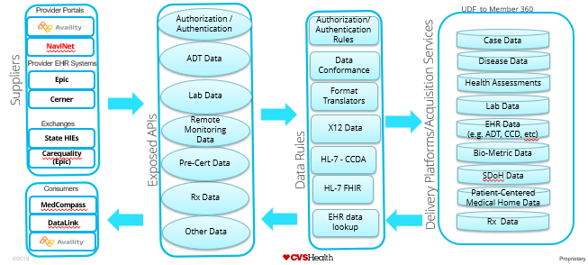
What does EHR Success look like?
In an ideal future state, CVS would provide an EHR Data Hub for known suppliers and consumers.
Why:
Keep Clinical data in CVS, not spread across multiple vendors - locking the data into the vendor system
Allow for ease of business evolutions or transitions
For Pop Health, VBC visibility purposes
Need:
Possible Individual consent of data passage.
Delete data on demand
Privacy by design
How:
Create an Enterprise EHR platform to host any and all EHR data.
Expose universal easily accessible “end-points” for Suppliers and Consumers (APIs)
Accept/Expose data in real-time or in batch.
Accept/Expose data in any format
Create format translators

Slide 8
Key takeaways
CVSH existing and future needs
Organizational Architecture:
CVSH business needs to have the flexibility to change or add solutions - whenever needed – we cannot be dependent on a partner business to move with CVSH
CVSH should have CVSH patient data, at CVSH – not spread across multiple vendor solutions
Aetna has learned some difficult lessons with where and how data is sourced or persisted – (most recently HealthBI).
CVSH needs to leverage EHR data for Clinical Platform operational and analytical reasons
CVSH must be able to react to legislative demands – e.g. individual privacy, “delete on demand” and consent..
What do we do today:
Raw electronic content is ingested and processed into structured and unstructured data sets
The Medicare Technical team uses multiple platforms and technologies, including, but not limited to: SAS, Linux, and Unix and Amazon web services
PDF charts are available which are scanned in office
Key Components for future
EHR vendors’ core business are the providers who purchase their software. Leverage EHR vendors (like Epic) to understand and value of the CVSH relationship to their business and revenue.
Determine how to refine data delivery to meet the specific needs of CVS business, (today all chart content is ingested, areas such as STARs may require a subset of data only.)
Increase patient matching rates through provider engagement
Increase provider education and collaboration
Notes:
Behavioral

Slide 9

Next Steps
To move CVSH forward in EHR integration, a nimble approach is necessary
Near-Term Action
(<6 months)
Long-Term Action
(>6 months)
Cross
Function
Team
including
O-CTO
Clinical
Security
Privacy
Legal
Research National EHR aggregators such as CommonWell & Carequality
Leverage existing vendors (e.g. Epic) to understand EHR landscape and roadmap
Research new vendors (e.g. Google Cloud DICOM, Redox) to see if they can help CVSH
Understand monetization strategy and legislative guidance
Develop target state architecture for implementation
Investigate organization such as Specialty pharmacy who have started consuming EHR data
Investigate member consent needs across various CVSH entities (Aetna, Minute Clinic, etc.)
Align across various organizations across CVSH to minimize duplicity
Create industry standard integrations (e.g. FHIR) with EHRs that can be reused with various EHR vendors
Leverage or Accommodate and be able to interact with the proposed new Interoperability law.
Integrate with CVSH Consent and privacy strategy to ensure appropriate access
Continuous monitoring of industry trends and revise strategy as necessary

Slide 11
Key sections of the EHR
8 key data sections of an EHR
1. Health Information and Data.
The electronic chart must hold everything that is currently included within a paper chart. For example:
Surgical history (e.g., operation dates, operation reports, operation narratives)
Obstetric history: (e.g., pregnancies, any complications, pregnancy outcomes)
Medications and medical allergies
Family History (e.g., immediate family member health status, cause of death, common family diseases)
Social History (e.g., community support, close relationships, past and current occupation)
Habits (e.g., smoking, alcohol consumption, exercise, diet, sexual history)
Immunization Records (e.g., vaccinations, immunoglobulin test)
Developmental History (e.g., growth chart, motor development, cognitive/intellectual development, social-emotional development, language development)
Demographics (e.g., race, age, religion, occupation, contact information)
Medical encounters (e.g., hospital admissions, specialist consultations, routine checkups)
History of the present illness
Physical examination (e.g., vital signs, muscle power, organ system examinations)
Assessment and plan (e.g., diagnosis, treatment).
Orders and prescriptions
Progress notes
2. Result Management. The ability to manage all test results (from labs, radiology reports).
3. Order Management. All prescriptions are to be written electronically to reduce medical errors due to illegible handwriting. Orders are also automatically generated.
4. Decision Support. Warnings/reminders to enhance clinical performance. Decision support can aid in: drug interactions/prescriptions/prevention, detection of disease outbreaks, evidence-based guidelines, etc. Overall, it will assist providers in making the best decision possible for the patient.
5. Electronic Communications and Connectivity. An interoperable system that is able to connect with multiple providers, the patient, labs, and hospitals in a secure manner.
6. Patient Support. The ability to provide patients with educational material as well as the ability to enter data themselves concerning home monitoring devices.
7. Administrative Processes. This is referred to as the Practice Management. The administrative process is to improve the efficiency in scheduling appointments, eliminate confusions, determine insurance eligibility, etc.
8. Reporting. A standardized system to produce reports that are demanded by state, federal, and local levels.

Slide 12
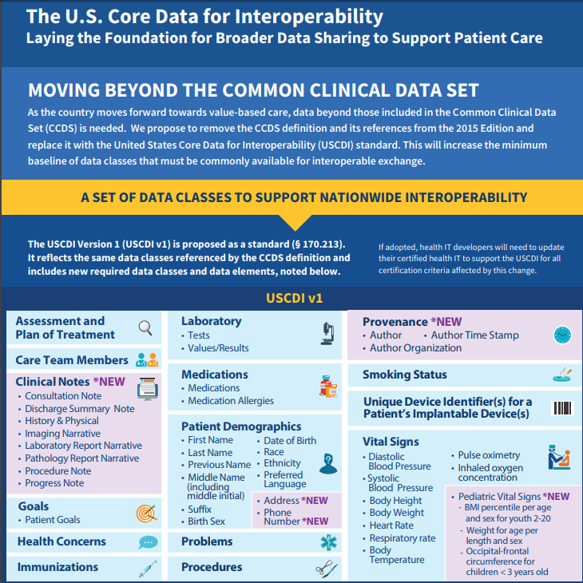
USCDI Core Data for Interoperability
EHRs are now being instructed to make USCDI Core Data accessible via FHIR APIs

Slide 13

EHR Proposed solution
EHR Data Hub within CVSH can help address some of the needs of our enterprise
Provider Portals
Authorization / Authentication
UDF to Member 360
Authorization/Authentication Rules
Case Data
NaviNet
ADT Data
Data Conformance
Disease Data
Suppliers
Provider EHR Systems
Epic
Health Assessments
Lab Data
Format Translators
Cerner
Lab Data
Exchanges
Remote Monitoring Data
X12 Data
EHR Data
(e.g. ADT, CCD, etc)
State HIEs
Exposed APIs
Data Rules
Bio-Metric Data
Carequality (Epic)
Pre-Cert Data
HL-7 - CCDA
SDoH Data
Rx Data
HL-7 FHIR
Delivery Platforms/Acquisition Services
Consumers
Patient-Centered Medical Home Data
MedCompass
DataLink
Other Data
EHR data lookup
Rx Data

Slide 14
EHR Needs
Capability breakdown of EHR needs
EHR Enterprise Needs
EHR Reference only for: Medication lists, Clinical Notes, Images, past Procedures and Prescriptions, current Orders
and Encounters
EHR Reference only for: Admit, Discharge and/or Transfer. Medication lists, adherence, reconciliation and Care
Coordination
EHR Reference only for: Medication lists, adherence and Care Coordination
EHR Reference only for: Medication lists, adherence and Care Coordination
No EHR Reference necessary
No EHR Reference necessary
EHR Update and Reference for: Current Medication lists, Medication adherence, Prescription details and fill-dates
EHR Update and Reference for: Clinical Notes, Images, past Procedures and Prescriptions, current Orders
and Encounters
From Aetna Heritage perspective: EHR Reference only for: Current Procedures for Gaps in Care studies only
Utilization Management
Med / Rx
Case
Management
Disease
Management
Behavior Health (and EAP) not clinical Encounter
Wellness Management
Incentive
Management (Member)
Medication
Therapy
Clinic
Encounters
Population
Health

